Slide 1
English Reading Skills Teacher Training
A guide for teaching English reading to early learners

Slide 2
PHONOLOGICAL AWARENESS What is it?
Educators call the ability to hear the smaller parts of spoken language and to work with them Phonological Awareness. Some people simply call it sound-language awareness. We will use both terms.

Slide 3
NOTES: SOUND-LANGUAGE AWARENESS
If students want to read, they must be able to understand the sounds of language.
The ability to hear the smaller parts of spoken language and to work with them is called Phonological Awareness.
The smallest part of spoken language is called a phoneme. Phonemic Awareness is the most advanced type of Phonological Awareness. We will talk about that in the next section.
Why is Phonological Awareness important?
Poor Phonological Awareness is a common reading weakness. This is an area where English language learners can especially have difficulties.

Slide 4
WHAT DOES SOUND-LANGUAGE AWARENESS LOOK LIKE?
Students with early Phonological Awareness can:
find and make rhymes
count words in a sentence
count the number of beats (or syllables) in a word
Students with later Phonological Awareness can:
blend small sounds into words
hear the same first sounds, like toe and tip
hear the same ending sounds, like sat and bit
hear the same middle sounds, like bag and tag

Slide 5
Stages of Phonological Awareness
PHONEMIC
AWARENESS
Hardest
Sound (Phoneme) Blending & Segmenting
Blending
(/c/ /at/ is cat)
Segmenting
(Cat is /c/ /at/)
Harder
How Phonological Awareness Progresses
Syllable Segmenting & Syllable Blending
Count words in a sentence.
Count syllables in a word.
Simplest
Same ending sounds (Rhyming)
The fat cat sat.
Same beginning sounds
Sally sells seashells.

Slide 6
TEACHING TIPS: PHONOLOGICAL AWARENESS
Know the difference between the name of a letter and the sound of a letter.
A letter between two slashes // is the sound.
So, the letter t represents the sound /t/. The word sat has three sounds: /s/ /a/ /t/.
Students should learn each letter by its sound, not its name.
At this early stage, say the sound of the letter, not the letter name.
For example, when teaching the letter a, say /a/ (as in ant) not /ai/ (as in aim).
The letter n should be said /n/ (as in net), not /en/.
This will help students blend the words later on.
When saying letter sounds for your students, do not add the /uh/ sound.
For example, when saying the letter f sound, do not say /fuh/.
Just say /fff/. Adding the /uh/ sound at the end of the letter sound makes it harder to later blend the sounds in a word.

Slide 7
TEACHING TIPS: PHONOLOGICAL AWARENESS
Teach easier consonants first. HOWEVER, some cultures have difficulty with certain sounds. If your students have trouble with some letter-sounds, teach easier ones. Below are some suggestions.
Some consonants are easier to say. You can s-t-r-e-t-c-h them out.
They are: m /m/, s /s/, f /f/, l /l/, r /r/, n /n/, v /v/, z /z/.
Some consonants end sharply with a puff of air. They are a little harder.
They are: b /b/, c /c/, d /d/, g /g/, p /p/, t /t/, k /k/, j /j/.
Some consonants are just plain difficult. Teach them last.
They are: h, w, y, x, q.

Slide 8
STRATEGY: PHONOLOGICAL AWARENESS Rhyming Games
First, what is a rhyme?
Words with the same sound at the end are rhyming words, like peep and sheep, go and slow.
Rhyming Games are useful pre-reading activities to teach sound-language awareness (or Phonological Awareness.)
Rhymes are in poems and songs. They are fun and easy to remember!
Notes
Before using a Rhyming Strategy, make sure your students know what a rhyme is.
Also, use words that they already know.
Use this strategy before reading. You can use it with the whole class, small groups, or individual students.

Slide 9
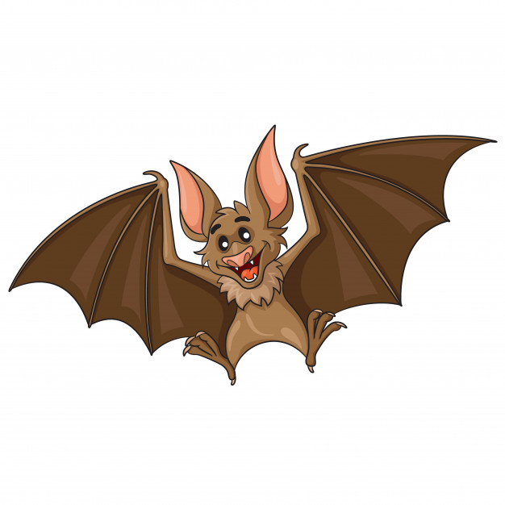
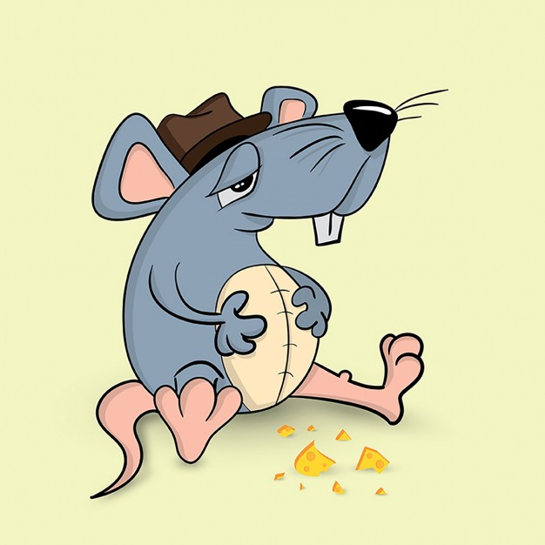
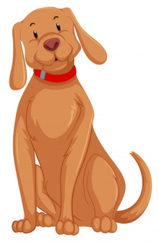
PHONOLOGICAL AWARENESS GAME: Match the Rhyming Picture
Set-up
Find pictures or objects for words that rhyme, including a couple that don’t.
They should have one beat (or syllable) and have short vowel sounds. For this example, the objects are hat, rat, bat, bag, dog.
If you want to use words, write these words in lowercase letters on cards. Underline the rhyming part. In this case, /at/.
For very early learners, you can play this game with only pictures and objects.
To make it more advanced, you can use word-cards for each word.

Slide 10
PHONOLOGICAL AWARENESS GAME: Match the Rhyming Picture
How to Play
To your class, show a picture or object of your target word.
Have the class name the target picture (or object): hat.
Show the other pictures (or objects.) Say each one with the class: rat, bat, bag, dog
Ask students up one at a time. They must choose an object.
The whole class says the name of the object. You ask: “Do they rhyme?”
If you are using word cards, show the word-card that goes with the picture. Have the class read each letter-sound and then read the part that is underlined. Explain that the underlined part is the part that rhymes.
Review all of your non-rhyming and rhyming items at the end of the game, whether they are pictures, objects or word-cards.

Slide 11
PHONOLOGICAL AWARENESS GAME: Match the Rhyming Picture
target word: hat
Rhyming Words
Non-Rhyming Words

Slide 12
STRATEGY: PHONOLOGICAL AWARENESS Break Down Sentences & Words
English often blends sounds together.
So, this early phonological awareness strategy is important.
With this strategy, students must break down sentences and words into smaller parts.
Easier: Students must break sentences into separate words.
When students hear “I like my friends” they hear four words.
Harder: Students must break words into separate syllables.
Students can break ”bookbag” into two beat, or syllables.
Notes
You can use this strategy before reading.
You can use it with the whole class, small groups, or individual students.

Slide 13
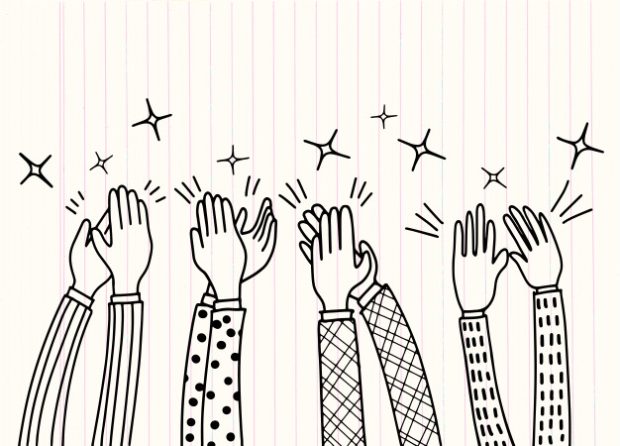
GAME: Clap Out the Words! (& Syllables!)
How to Play
Use a short poem the students know or write your own. For example, you can use the poem: "I scream you scream we all scream for ice cream!"
As you say the words, students clap their hands for each word.
Then make it harder! Tell them to clap for each syllable in a word. Start with words with one syllable, then two then three or even four.
Use words from their home language or their names.
“Sumarra. Su (clap) mar (clap) ra (clap)!”
Notes
In this game, students use clapping (or some other movement) to break sentences into words.
Then they break words into syllables. (This is harder.) Then break words into phonemes. (This is really hard!)
This game uses the body. It is also musical. These can both help language learners.

Slide 14
ASSESSMENT FOR PHONOLOGICAL AWARENESS
Phonological Awareness is a necessary part of reading instruction. It is important to assess students. This will help you to plan your lessons.
Here are some examples of questions for assessing Phonological Awareness:
Counting Words
TEACHER: How many words are in this sentence? "You are my friend.”
STUDENT: 4
Do They Rhyme?
TEACHER: Do these words rhyme: bit, sit?
STUDENT: Yes
TEACHER: Do the words big and bag rhyme?
STUDENT: No
TEACHER: What about key, tree?
STUDENT: Yes

Slide 15
ASSESSMENT FOR PHONOLOGICAL AWARENESS
Syllable Blending
TEACHER: I am going to say a word in parts. Listen: o - pen. What word did I say?
STUDENT: open
TEACHER: What word do these sounds make? /p/ – /ot/
STUDENT: pot
TEACHER: How about /s/ – /at/?
STUDENT: sat
Syllable Segmentation (Break a Word Into Syllables)
TEACHER: Can you tell me the syllables (or sound parts) in open?
STUDENT: o - pen
Syllable Deletion
TEACHER: Say sat without the /at/.
STUDENT: /s/

