Slide 1
INSTRUCTIONAL CLASSROOM LANGUAGE
Tips for giving clear instructions!

Slide 2
There are 2 basic types of Classroom Instruction.
General Classroom Instructions
These instructions help you to manage your class. You may say them many times a day.
They include such language as:
Please come in!
Please take your seat.
Please be quiet.
Now, let’s take a break.
2. Specific Activity Instructions
These instructions help you to teach an activity, like a game or art project.
They include such language as:
Take your paper and fold it in half.
Please sit in a circle on the floor.
Use your crayons to color your picture.
DEFINITIONS:
The adjectives “general” and “specific” are opposites.
“General” relates to the whole of something rather than the details.
“Specific” relates to a particular person, situation, or detail -- in this case, an activity.

Slide 3
WRITE DOWN COMMON INSTRUCTIONS AND POST THEM IN YOUR CLASSROOM
General Instructions
These instructions may include:
“Please come in!”
“Please take your seat.”
“Please be quiet.”
“Now, let’s take a break.”
“Close your book.”

Slide 4
Giving instructions for activities has 3 basic steps:
Step 1. Prepare
Step 2. Deliver
Step 3. Monitor

Slide 5
Step 1. Prepare
Activity Instructions

Slide 6
PLAN WHAT TO SAY, WRITE IT DOWN, PRACTICE
Step 1. Prepare
First, plan what to say. If it helps, try to see the activity happening in your mind.
Then, write the instructions down. You can write them as you prepare your Lesson Plans.
Before your class, practice alone, with a friend or with your partner teacher. This can help you to feel more confident.

Slide 7
HAND OUT MATERIALS AFTER YOU GIVE INSTRUCTIONS (…USUALLY)
Step 1. Prepare
Materials -- like colorful pencils and paper -- could distract students. (This means they pay attention to the materials and not you!)
­
However, if students need the materials to understand the instructions, hand the materials out before.
Colorful pencils
Colorful crayons
Colorful papers

Slide 8
ARRANGE THE CLASSROOM BEFORE GIVING INSTRUCTIONS
Step 1. Prepare
If you need to move around desks or chairs in the classroom – or group your students – do this before you give instructions.
The students may forget the instructions after so much moving around.

Slide 9
GROUP STUDENTS BEFORE GIVING INSTRUCTIONS
Step 1. Prepare
If your students need to work with a partner, pair them yourself. This will save time.
It will also allow you to partner students based on their abilities. For example, stronger students can help weaker students.
However, if finding a partner or joining a group is part of your lesson, of course, the students should do it themselves.

Slide 10
Step 2. Delivery
Activity Instructions

Slide 11
USE BODY LANGUAGE
Step 2. Delivery
Body language is movements of the body that help to communicate meaning. Use body language when you explain instructions to your class.
For example, when you say “listen to me,” you can point to your ear. And if you say, “raise your hand,” you should raise your hand.
Use your face and your voice too!

Slide 12
USE OBJECTS AND OTHER VISUAL AIDS
Step 2. Delivery
Objects and other visual aids help too!
For example, if you tell your students to write with a pencil, show them a pencil and pretend to write.

Slide 13
What body language or visual aids can you use for these instructions?
Step 2. Delivery
Please come in. Please sit down.
Please be quiet. Please raise your hand.
Open your book. Close your book.
Open your notebook. Close your notebook.
Take out a pen. Take out a pencil.
Please take a sheet of paper. Pass the rest around.
Everyone stand up and form a circle.
Everyone come to the front of the classroom and make a line.
Now, let’s sing the song all together!

Slide 14
USE SIMPLE LANGUAGE & PAUSES
Step 2. Delivery
When you give instructions, use very simple language.
And pause often. When you stop for a minute, your students have time to think about the instructions.

Slide 15
Examples of Simple Language
Step 2. Delivery
This language is not simple.
This language is simple.
If you would please take out your books, I would like you to please open them to page 10.
Once everyone is on page 10, I will get started reading that text.
While I read the text, please do not talk or make others noises.
Open your book to page 10.
Now, I will read.
Please be quiet.

Slide 16
DO NOT GIVE LONG INSTRUCTIONS ALL AT ONCE
Step 2. Delivery
If an activity has many steps, don’t give all of the instructions at one time. Otherwise, students may forget some of them.
Break long instructions into smaller parts.

Slide 17
SET A TIME LIMIT
Step 2. Delivery
Time limits are important! Students need to know, “How much time do I have to finish this activity?” Time limits allow students to pace themselves.
Tell your students: “This activity will take 15 minutes.” Or “We will spend 20 minutes on this activity.”

Slide 18
MODEL INSTRUCTIONS / LET STUDENTS LEAD
Step 2. Delivery
Model the instructions with a student or partner teacher. Show the class how to do the activity.
This is a great way to show the activity in action!
Some activities you will do often with your class.
Once your students know the instructions, you can ask them to explain the activity to the class.
This is great for their English and their confidence!

Slide 19
MAKE SURE ALL YOUR STUDENTS UNDERSTAND
Step 2. Delivery
After giving instructions, you need to find out if your students understand.
But students might be embarrassed to say if they don’t understand. Or they may think they understand, but they do not.
Here are 2 ways to check their understanding:
1. Ask some students to explain the instructions in their own words.
2. Pick some students and ask them questions about the instructions.

Slide 20
TELL YOUR STUDENTS WHEN TO BEGIN
Step 2. Delivery
Finally, tell your students when the activity starts.
Here are some examples:
Let’s begin!
Let’s start!
Now, let’s play!
When I say “go,” go!
On your mark, get set, go!

Slide 21
Step 3. Monitor
Activity Instructions

Slide 22
Did your students understand?
Step 3. Monitor
MONITOR YOUR STUDENTS
As your students do the activity, walk around and watch them. Are they doing it properly?
If they are having a hard time, stop the activity.
Repeat any part of the instructions they did not understand.
You may have to give all of the instructions to the whole class again.

Slide 23
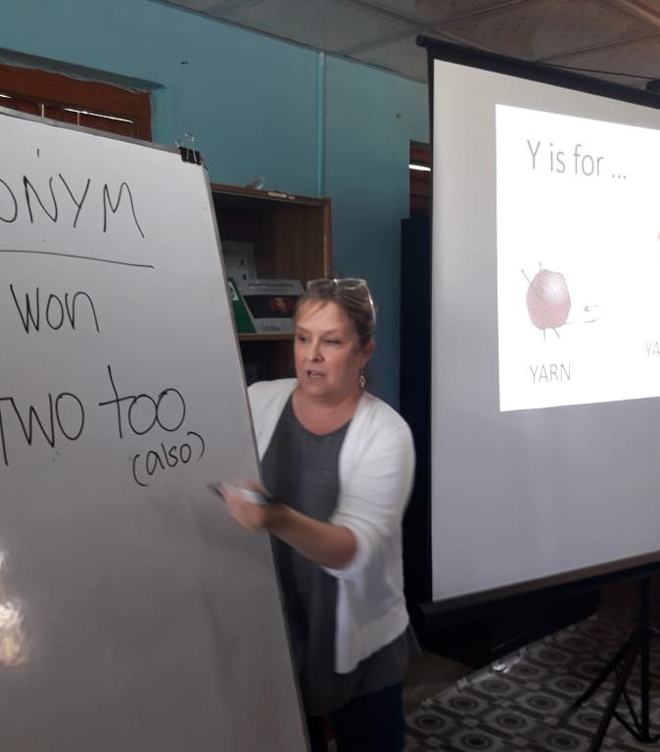
WRAP-UP
Use these tips when you give instructions to your class.
Keep a list of tips in your teaching materials.
Add to the list as you discover your own tips!

Slide 24
DEFINITIONS OF USEFUL TERMS
back-up – n. something (or someone) that serves as a substitute or support
basic – adj. the simplest and most important parts of something
body language – n. movements or positions of the body that express a person's thoughts or feelings
checklist – n. a list of things to be checked or done
complex – adj. not easy to understand or explain : not simple
confidence – n. a feeling or belief that you can do something well or succeed at something

Slide 25
DEFINITIONS OF USEFUL TERMS
confused – adj. unable to understand or think clearly
distract – v. to cause someone to stop thinking about or paying attention to someone or something and to think about or pay attention to someone or something else instead
embarrassed – adj. to feel foolish in front of other people
feedback – n. helpful information that is given to someone so they can make improvements
general – adj. having to do with the whole : not specific or detailed
icon – n. a small picture that represents something else : For example, a smiley face is an icon for something happy.

Slide 26
DEFINITIONS OF USEFUL TERMS
pace – v. to control or set the speed of someone or something
pause – n. a period of time in which something is stopped before it is started again
peer – n. a person who belongs to the same age group or social group as someone else
pretend – n. to make believe
specific – adj. relating to or being an example of a certain kind of thing
tip – n. a piece of useful information
veteran – n. a person who has had long experience

