Slide 1
Voice of America
Mission Brief | 2020
Adriana Núñez Rabascall, Caracas, Venezuela, May 1, 2019

Slide 2
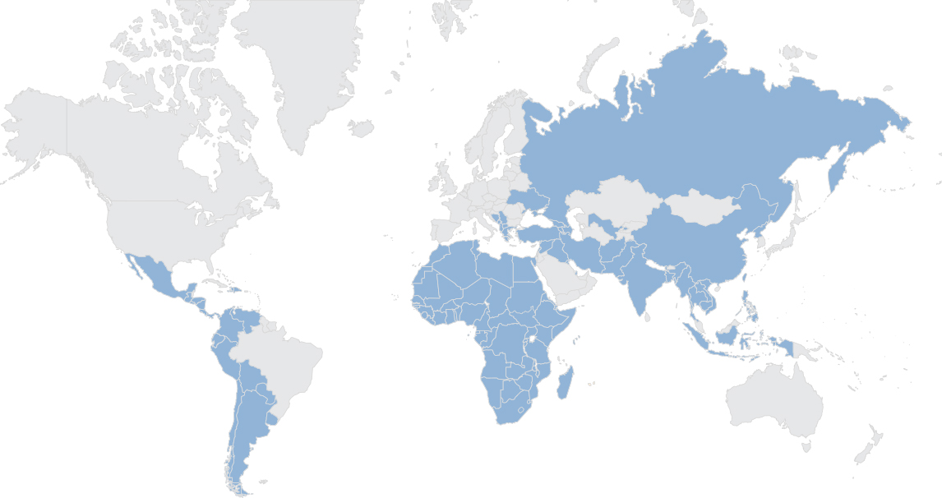
Who We Are
International broadcasters providing news and information to 85 countries in more than 40 languages via television, radio, web and mobile.
Weekly audience of 280.9 million (FY19)
Annual budget: $250.06 million (FY19)
1000+ workforce

Slide 3
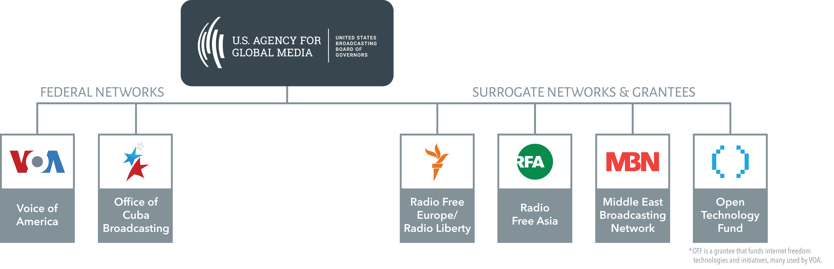
VOA is one of five networks under the U.S. Agency for Global Media

Slide 4

Why We Were Created
During WWII, in response to the needs of closed societies and war-torn countries, VOA’s accurate and objective news reports countered the onslaught of Nazi and fascist propaganda.

Slide 5

Press Freedom
Many countries limit or prohibit a free and independent press. Throughout World War II, the Cold War, the fight against global terrorism and the struggle for freedom around the globe today, VOA exemplifies the principles of a free press.
For many nations, VOA is the only source of reliable news and information.
Despite interference by foreign governments, VOA continues its broadcasts.
Press freedom around the world continues to decline.
“The liberty of the press is essential to the security of the state.”
John Adams (Second president of the United States)

Slide 6
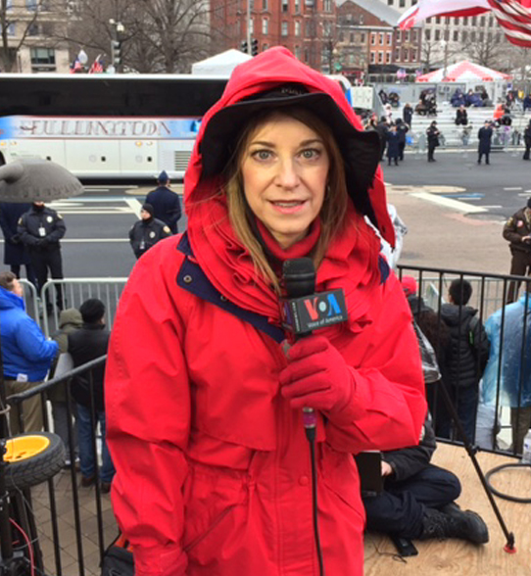
The Charter
VOA will:
Serve as “a consistently reliable and authoritative source of news.”
Be “accurate, objective, and comprehensive.”
“Represent America… through a balanced and comprehensive projection of significant American thought and institutions.”
“Present the policies of the United States and foster responsible discussion and opinion of these policies.”

Slide 7
Firewall
The editorial integrity of VOA journalists is ensured by the “firewall” that was first codified in the VOA Charter of 1976 and later reinforced in the U.S. International Broadcasting Act of 1994 and the National Defense Authorization Act of 2016.
Prohibits interference by U.S. government officials, including officials of USAGM, in news coverage
Requires VOA journalists to develop content of the highest journalistic standards that is free of political interference

Slide 8
VOA & Journalism Initiatives
Collaborating with Arizona State University’s Cronkite School of Journalism, VOA contributes to transparency, working collectively on software to make it easier and quicker for journalists to post visible corrections to stories.
Participates in a state-of-the-art coalition of news industry standards editors that meets quarterly, tackling the toughest journalistic challenges facing news organizations today.
As a member of the #OneFreePress coalition, VOA joins prominent editors and publishers using its global reach to spotlight journalists who are under attack.

Slide 9
Smith-Mundt Act
Passed by Congress in 1948, the Smith-Mundt law prevents VOA from broadcasting in the United States.
The law was amended in July 2013 allowing VOA to share only original content inside the U.S. upon request.
VOA can accept requests for one-time use of its radio, TV or web original products.
VOA can accept requests for ongoing use of its programs, unless they originate from an entity that intends to broadcast our content to audiences located within the United States.

Slide 10
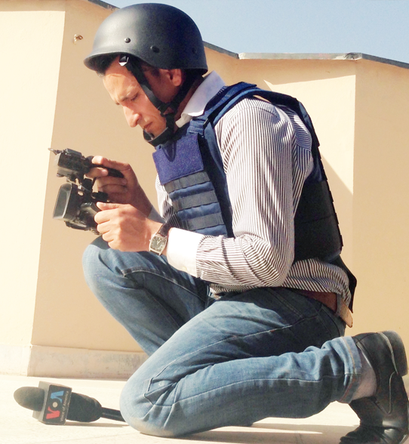
Risking Their Lives
VOA journalists often report from dangerous areas of the world, covering wars, regional conflicts and natural disasters.
VOA journalists have lost their lives in pursuit of the truth and regularly experience threats and harassment while reporting in authoritarian regimes.

Slide 11
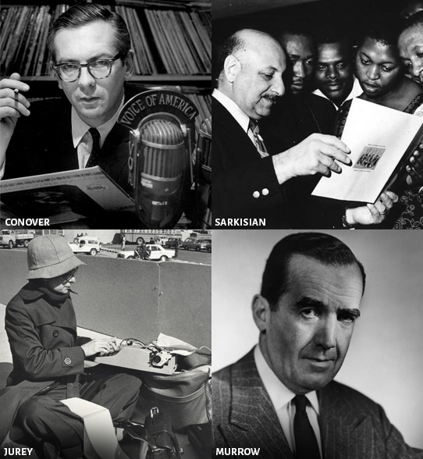
Hall of Fame
Willis Conover – Credited with introducing jazz to many parts of Eastern Europe through his VOA radio broadcasts.
Leo Sarkisian – Brought African music to millions through his VOA radio show “Music Time in Africa.”
Edward R. Murrow – Led the U.S. Information Agency, the predecessor of USAGM.
Philomena Jurey – One of the first female White House correspondents, she covered U.S. presidents Nixon, Carter, and Reagan.

Slide 12

Today’s VOA Broadcasters
Some of today’s VOA broadcasters include:
Steve Herman – White House bureau chief who spent 26 years reporting from Asia including in Japan, India, South Korea, and Thailand.
Myroslava Gongadze – Chief of VOA’s Ukrainian service, award-winning reporter, named one of 100 most successful women in Ukraine by “New Time” magazine.
Navbahor Imamova – A leading authority on geopolitics and national development in Central Asia and the only U.S. journalist to receive accreditation from the Republic of Uzbekistan to work as foreign media correspondent inside that country.
Roger Muntu – A well-known radio and television host in francophone Africa. His popular “RM Show” radio program and “Vous et Nous” TV program feature music and conversation with some of the region’s most notable personalities.

Slide 13

Covering America,
Broadcasting to the World
Headquartered in Washington, D.C., VOA reporters are at the White House, State Department, Pentagon and the U.S. Congress, as well as in bureaus around the world.
VOA has 14 television and 40+ radio studios in the U.S., serving more than 40 language services.

Slide 14
Areas of News Coverage
America’s Story. Gives international audiences a look at life in the United States — its people, government, values, and culture.
Refugees. Content by and for refugees engages and informs communities at risk.
Extremism. The Extremism Watch Desk reports on terrorist activities around the world.
Press Freedom. Serves as a model of a free press, especially in authoritarian areas such as China, Iran, North Korea and Russia.
Science & Technology. VOA’s Silicon Valley bureau provides in-depth coverage of innovation and entrepreneurship.
Women’s Issues. Often under-covered by local media, VOA reports on women as equal actors in the global story.
Disinformation. Polygraph.info, a fact-checking website, identifies false or misleading information, with an emphasis on Russian-Western relations.
Notes:
Speaker note: * speaker can talk more in depth about each unit depending on audience interest

Slide 15
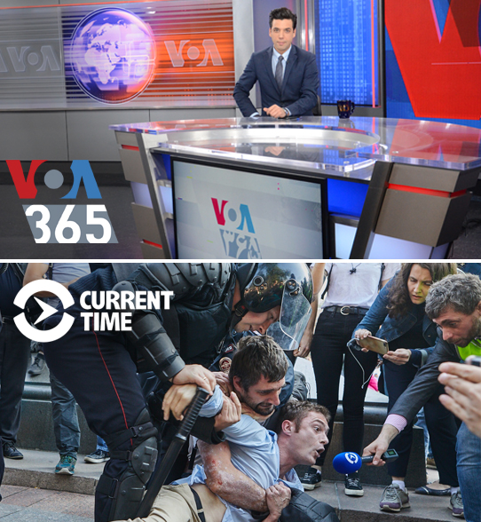
VOA – RFE/RL Joint Ventures
VOA 365: This global cross-platform effort by VOA & RFE/RL is the re-launch of programming confronting the Iranian regime’s disinformation efforts, with Persian-language programs inside Iran and to the global diaspora.
Current Time TV: The 24/7 Russian-language TV & digital network by RFE/RL & VOA provides a trustworthy alternative to Kremlin-controlled media in 26 countries throughout Europe and Eurasia.

Slide 16
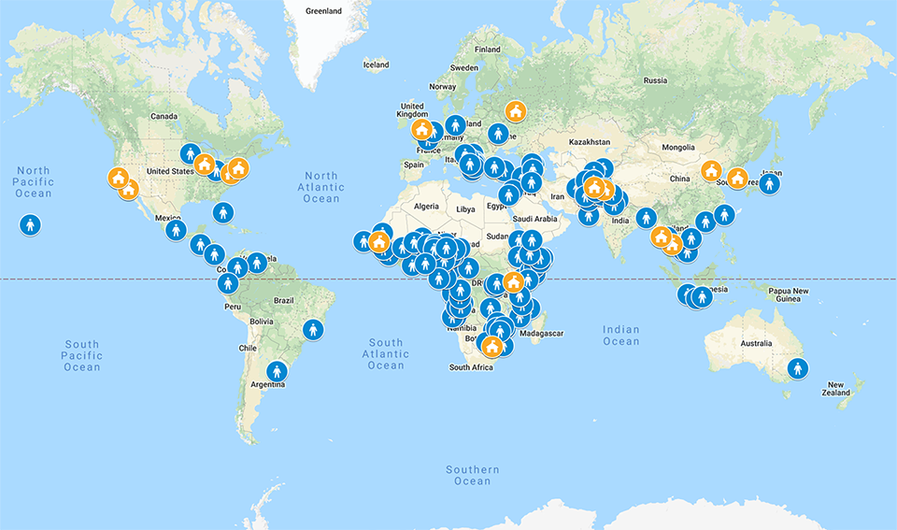
Worldwide Presence
VOA has a vast network of correspondents and freelancers around the globe who report in multiple languages.
VOA has bureaus and reporters in:
Africa
Asia
Europe
Latin America
United States

Slide 17
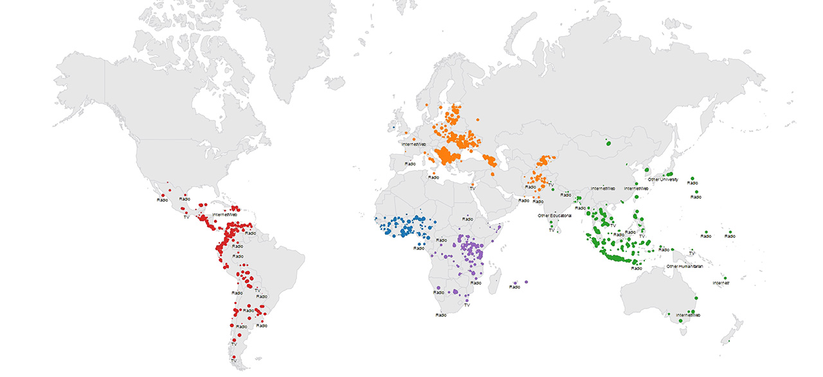
VOA Works with Local Broadcasters
A network of more than 3,000 affiliate stations broadcasts VOA content.

Slide 18
VOA Weekly Audiences 2014-2019
(in millions)

Slide 19
83% of Surveyed Global Audiences Trust VOA*
Afghanistan | 79% | Kenya | 85%
China | 89% | Nigeria | 90%
DRC | 89% | Pakistan | 73%
Ethiopia | 98% | Russia | 49%
Haiti | 92% | Somalia | 87%
Indonesia | 79% | Turkey | 79%
Iran | 67% | Ukraine | 65%
The trust data for these and 19 other countries is based on surveys of a statistically significant portion of adult populations in those countries, measuring their trust in VOA to tell the truth. Each survey was conducted by one of a number of global research companies (including Gallup and Kantar) contracted to VOA between 2014 and 2019.
*Representing more than 80% of VOA's total global audience

Slide 20
Social Media Growth 2014-2019
(in millions)

Slide 21

Awards & Honors

Slide 22
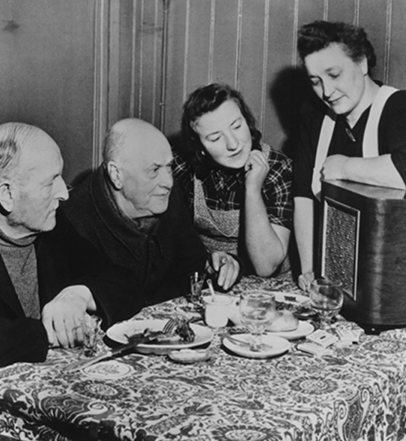
Our Promise
“The news may be good.
The news may be bad.
We shall tell you the truth.”
William Harlan Hale, first VOA broadcast, 1942

Slide 23
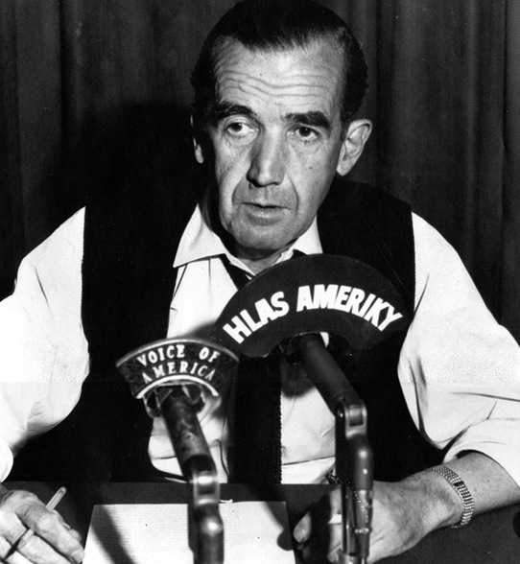
“To be persuasive we must be
believable; to be believable we must be credible; to be credible we must be truthful.”
Legendary broadcaster Edward R. Murrow, 1963
Director of the U.S. Information Agency (the predecessor of USAGM), 1961–1964

Slide 24
Questions

Slide 25
Additional Slides
Feel free to add slides to tailor content to your presentation.
There are several slide masters in the document for your use.
Font styles and colors should not be changed so the final presentation is visually cohesive.
Please delete this slide when finalizing your presentation.

Slide 26

VOA Music Programs
Local and regional music
  Music experts, artists and listeners
Western and U.S. music
  Jazz
  Pop
  Variety
  Interviews with artists & listeners

Slide 27
VOA Language Service Music Programs
VOA English Radio & TV
  VOA1 – 24/7 Radio – Pop, Country, Jazz hits and variety shows
  Crossroads TV
VOA Africa Division
  In English: Music Time Africa – Hosted by ethnomusicologist Heather Maxwell
  Shows in Swahili, Bambara & French – African and Western Music
VOA East Asia Division
  Three language services host radio shows: Korean, Indonesian and Lao.
  Indonesian Crossroads TV
VOA South and Central Asian Division
  Shows in Urdu and Deewa

