Slide 1
Pakistan Elections Factsheet

Slide 2
Pakistan Official population figure: 180.2 million
Total Electoral vote: 85,738,789
Pakistan Official population figure: 180.2 million
Total Electoral vote: 85,738,789
Region-wise electoral breakdown
Male Voters | Female Voters | Totals
Baluchistan | 1,922,628 | 1,422,439 | 3,345,067
FATA | 1,153,073 | 596,258 | 1,749,331
Federal Area | 330,777 | 283,399 | 614,176
Khyber Pukhtunkhwa | 7,049,265 | 5,261,736 | 12,311,001
Punjab | 27,624,870 | 21,380,771 | 49,005,641
Sindh | 10,335,800 | 8,377,773 | 18,713,573
Total | 48,416,413 | 37,322,376 | 85,738,789
Number of seats in Pakistan National parliament (National Assembly & Senate)

Slide 3
National Assembly 342
(It includes 60 seats reserved for women and 10 for non-Muslims, as per Article 51).
Province/Territory | General Seats | Women | Non-Muslims | Total
Federal Capital | 2 | – | – | 2
Punjab | 148 | 35 | – | 183
Sindh | 61 | 14 | – | 75
KPK | 35 | 8 | – | 43
Balochistan | 14 | 3 | – | 17
FATA | 12 | – | – | 12
Total | 272 | 60 | 10 | 332+10 = 342

Slide 4
Senate seats: 104
Provinces / Territories | General | Technocrats / Ulema | Women | Non-Muslims | Total
Sindh | 14 | 4 | 4 | 1 | 23
Punjab | 14 | 4 | 4 | 1 | 23
Balochistan | 14 | 4 | 4 | 1 | 23
Khyber Pakhtunkhwa | 14 | 4 | 4 | 1 | 23
Federal Capital | 2 | 1 | 1 | - | 4
FATA | 8 | - | - | - | 8
G. TOTAL | 66 | 17 | 17 | 4* | 104
Four seats for non-Muslims increased through the Constitution (Eighteenth Amendment) Act, 2010 (Act No. X of 2010) shall take effect from the next Senate Election.
Minimum age for voting in Pakistan: 18
Minimum age for becoming National Assembly candidate? 25 years.
Minimum age for becoming a candidate for a Provincial Assembly is 25 years.
Minimum age for contesting elections to the Senate is 30 years.
Minimum age for becoming a candidate for office of the
President is 45 years.
Pakistan constitution calls for general elections every five year.

Slide 5
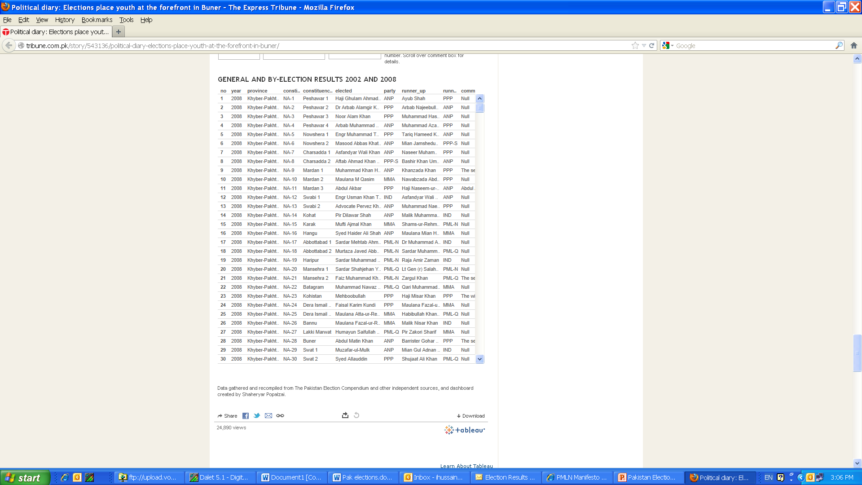

Slide 6
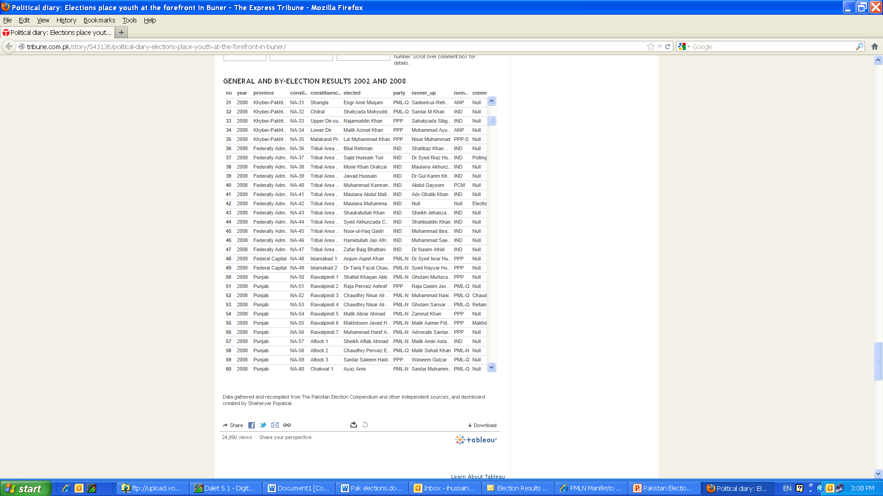

Slide 7
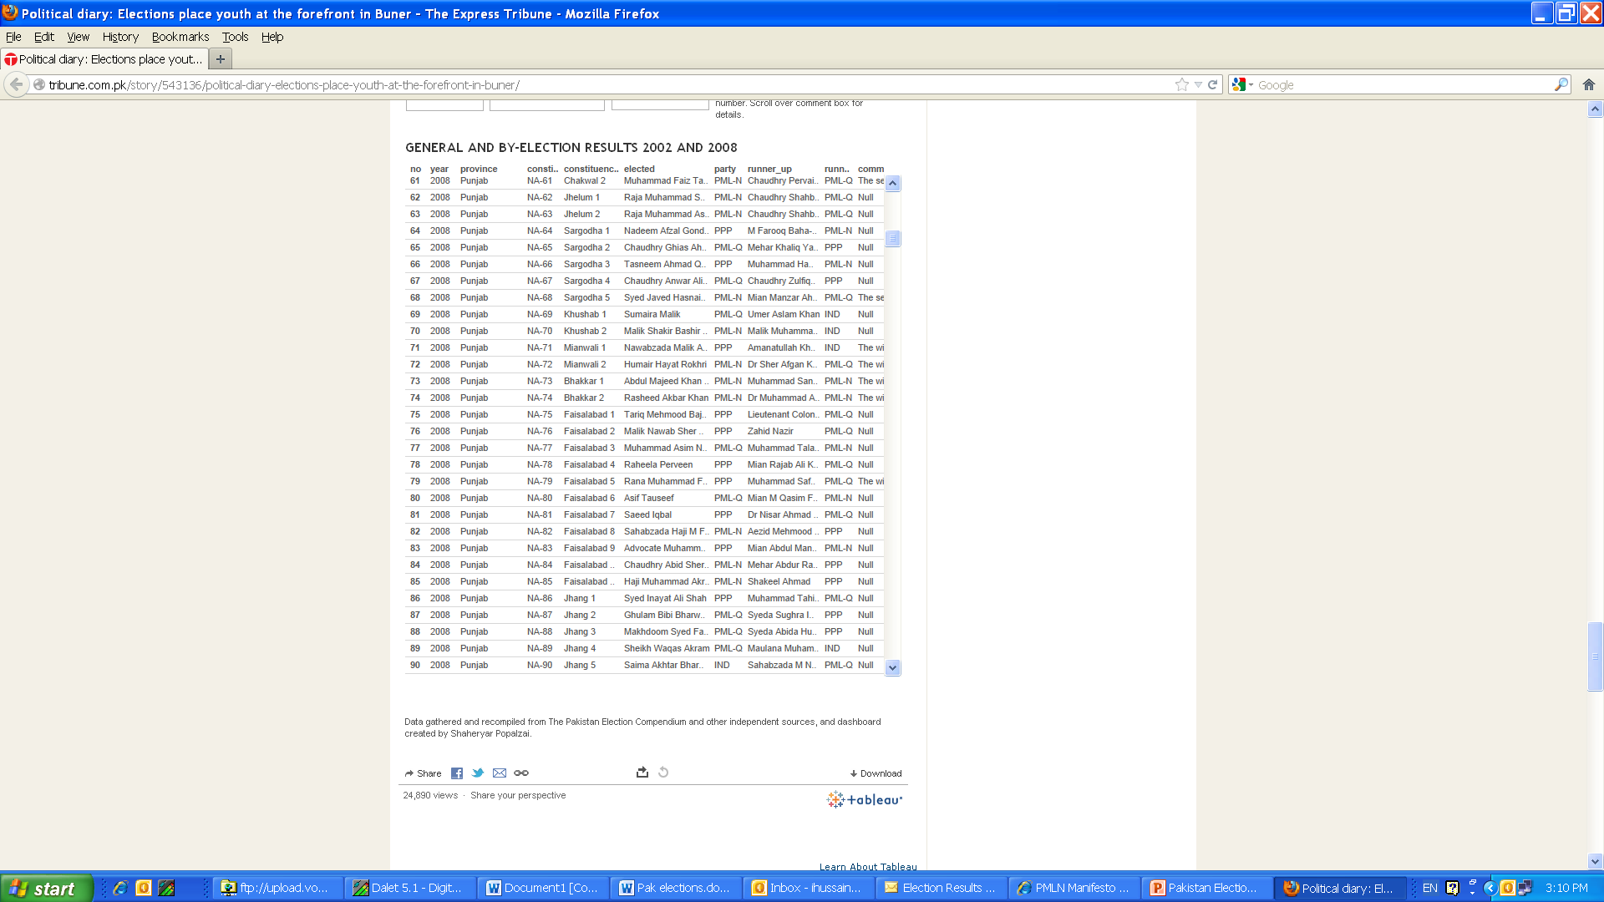

Slide 8
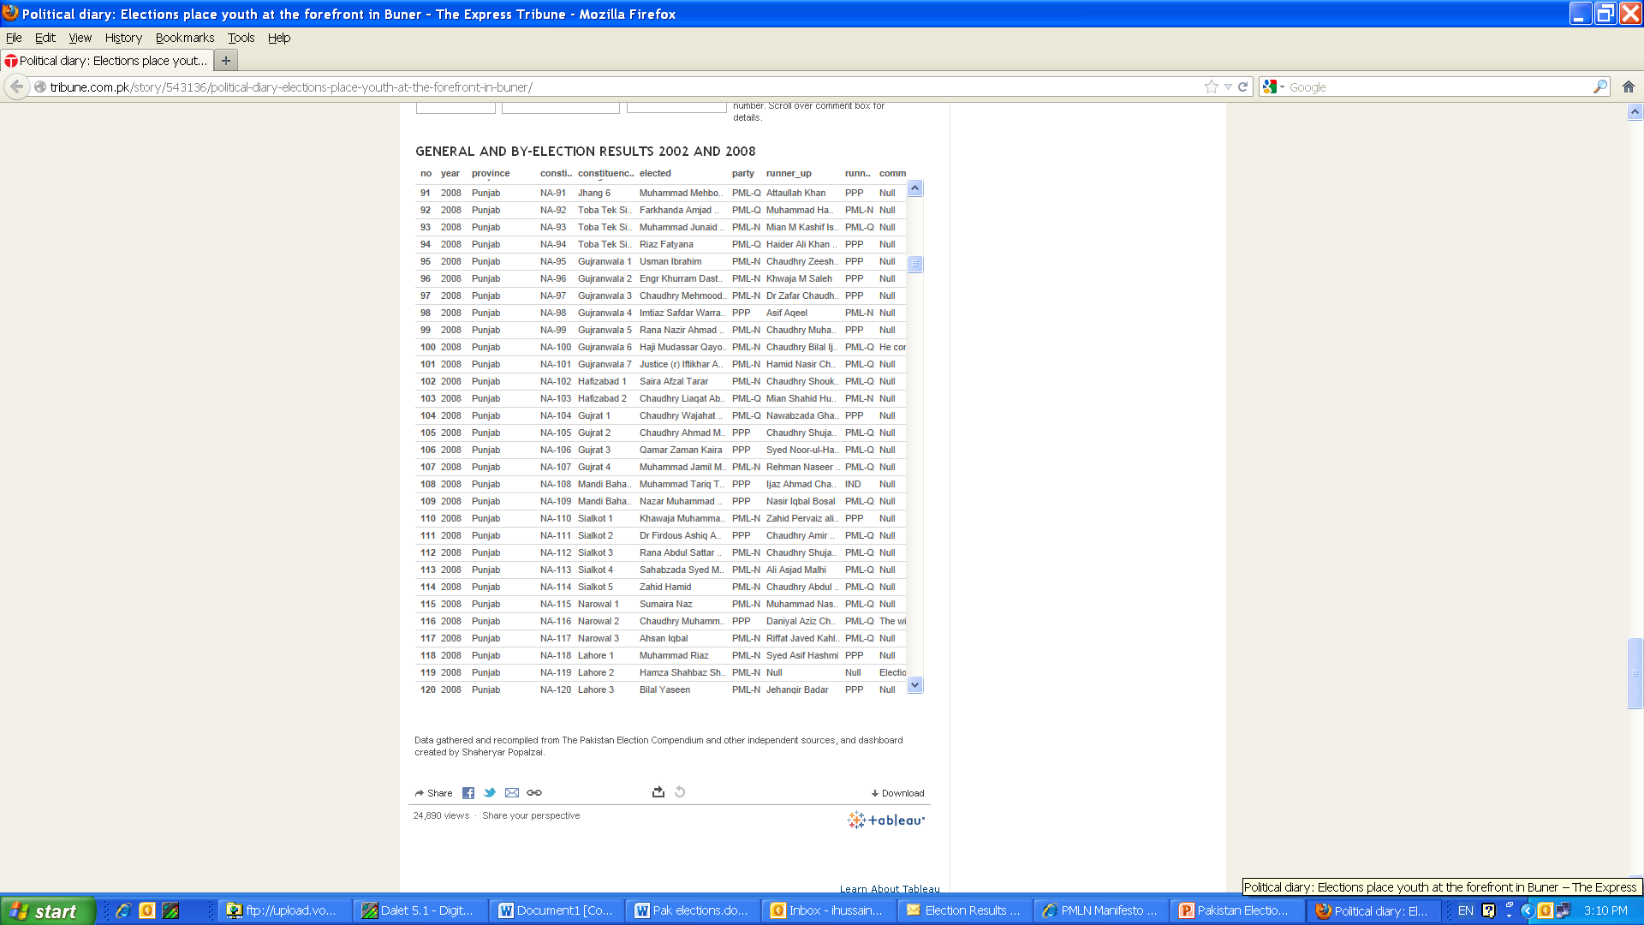

Slide 9
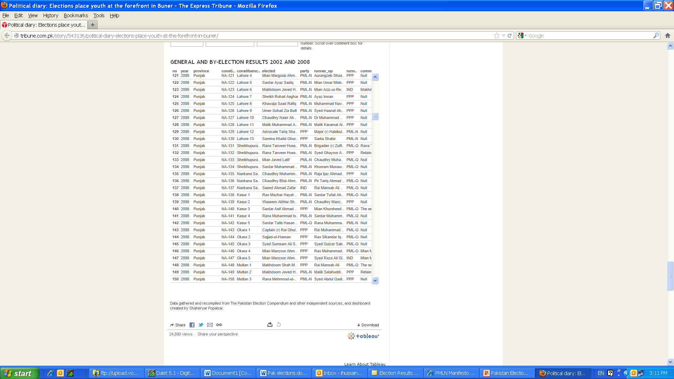

Slide 10
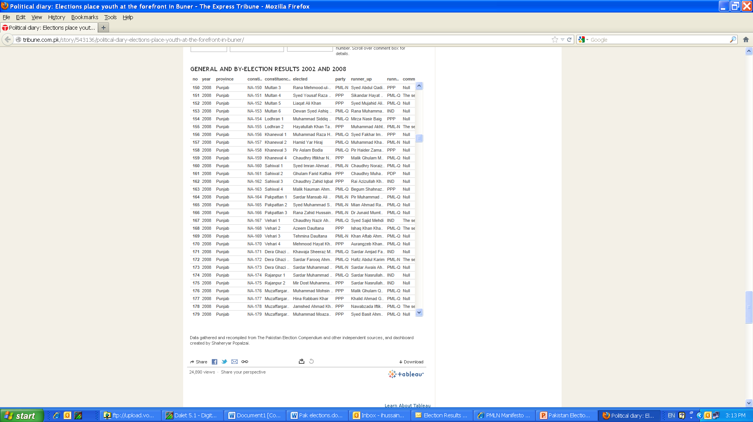

Slide 11


Slide 12


Slide 13
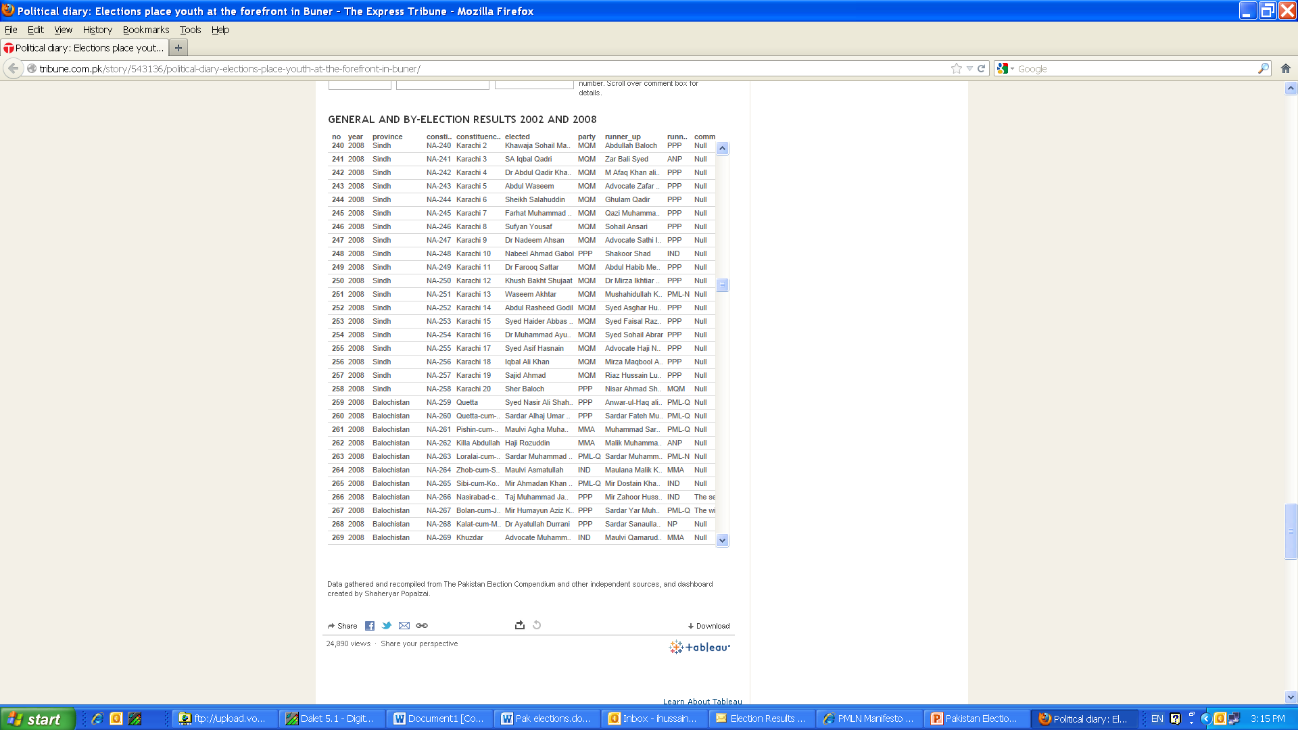

Slide 14
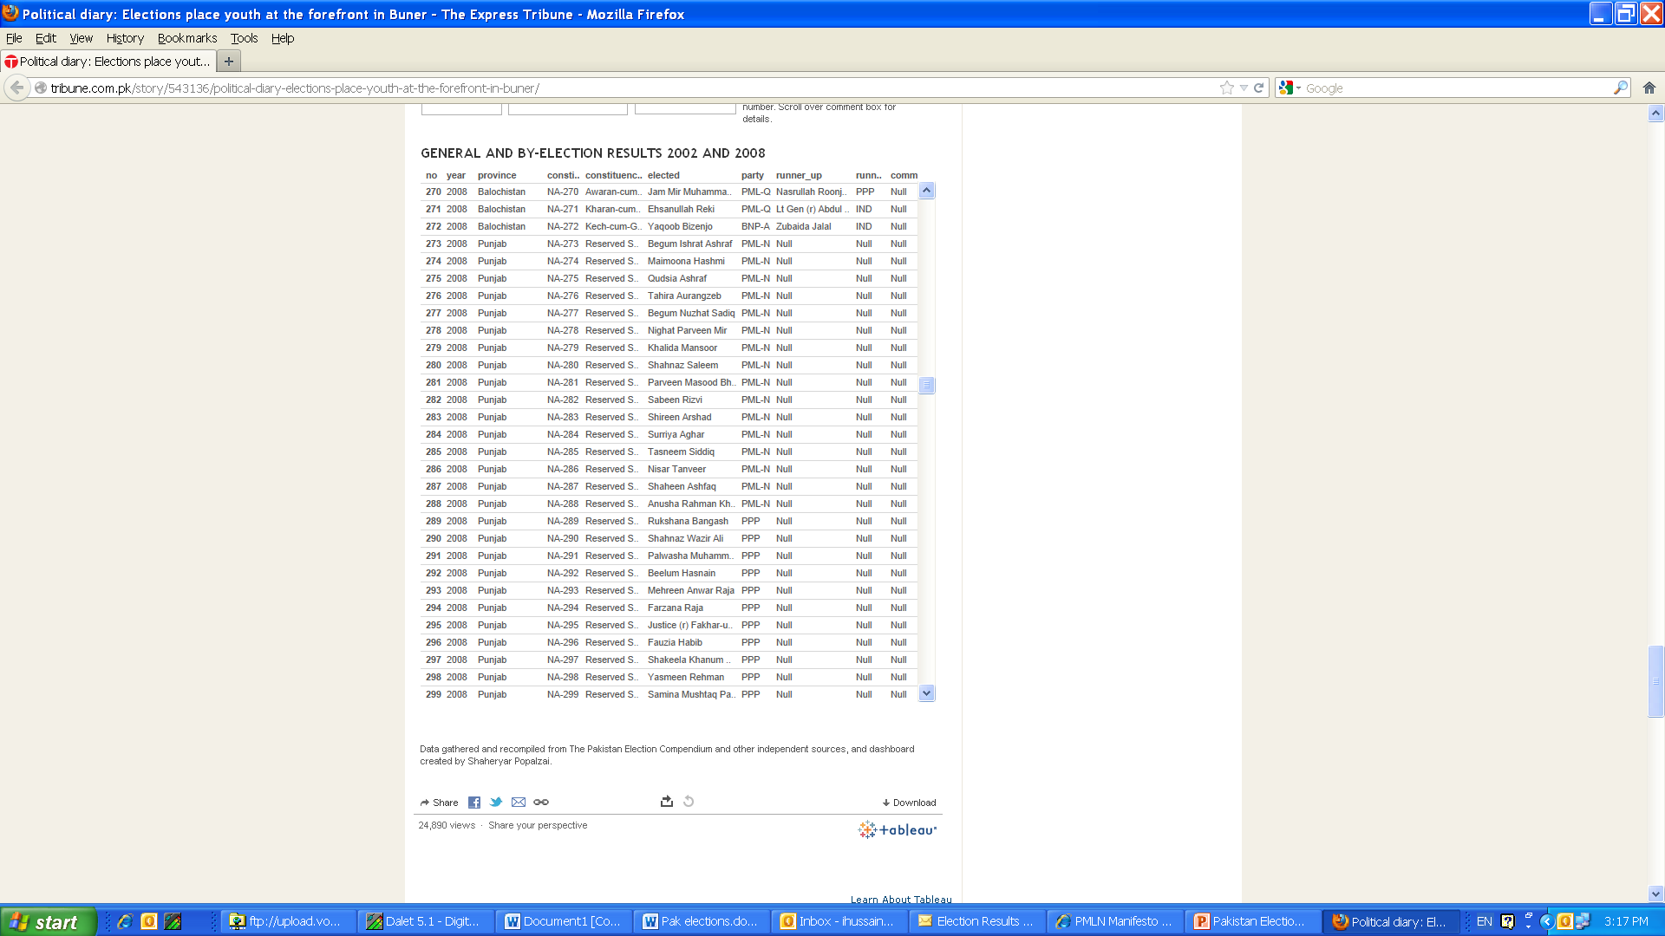

Slide 15
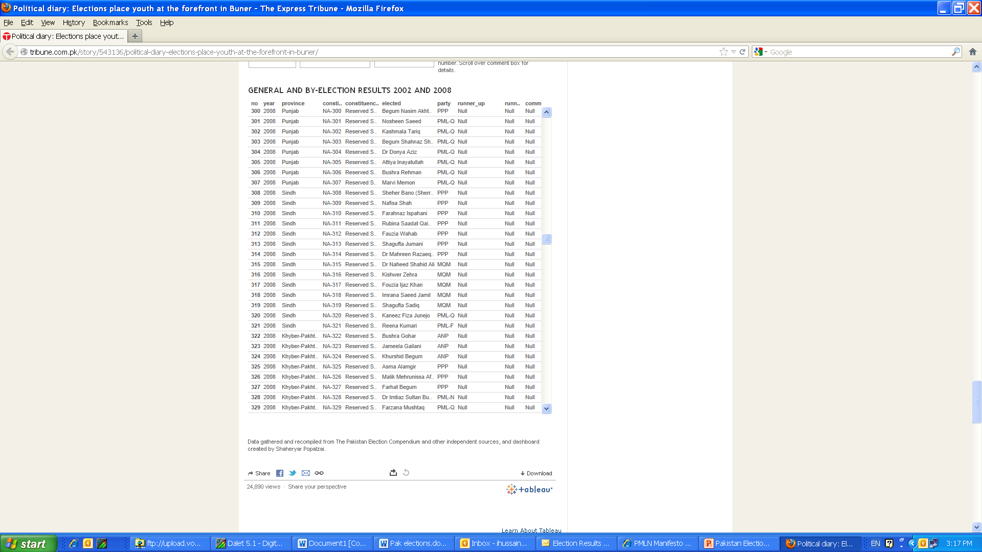

Slide 16
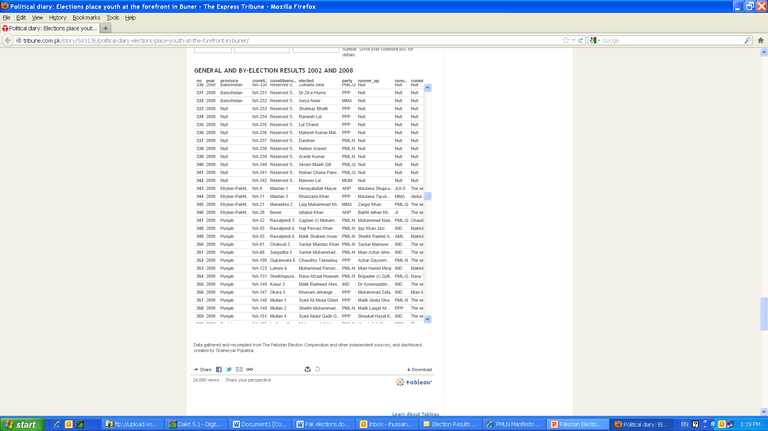

Slide 17
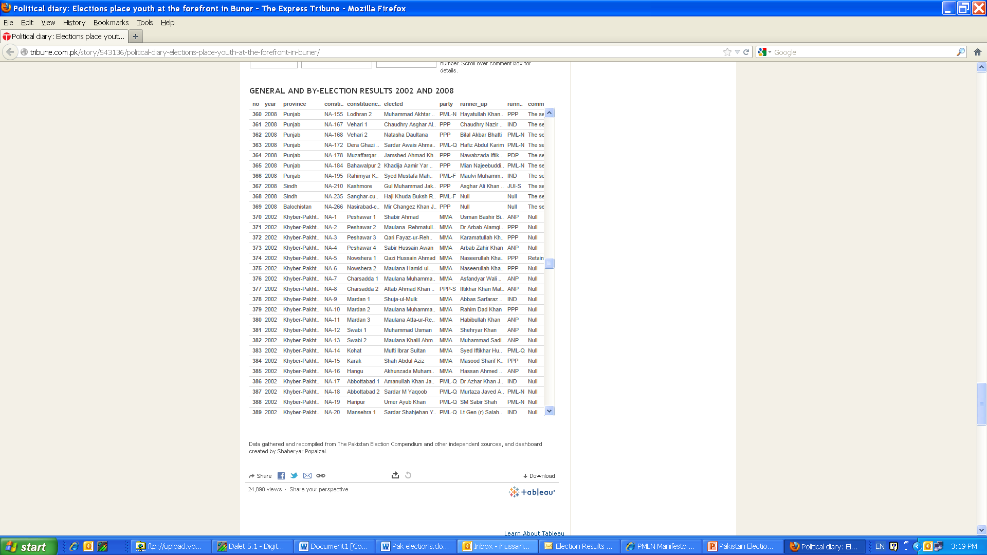

Slide 18
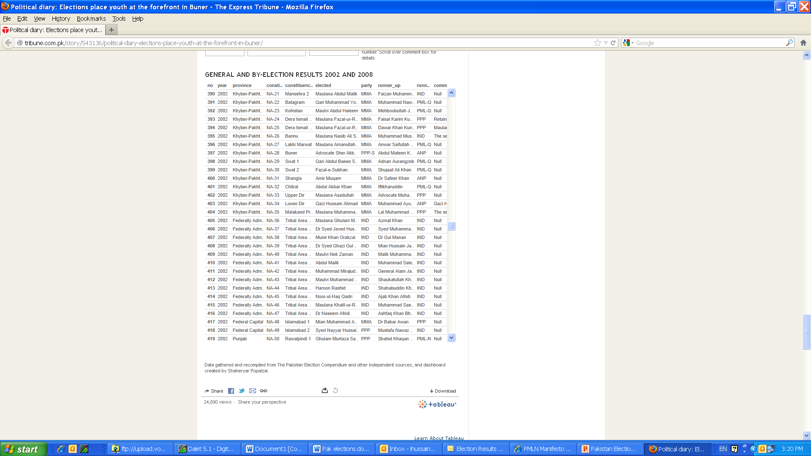

Slide 19
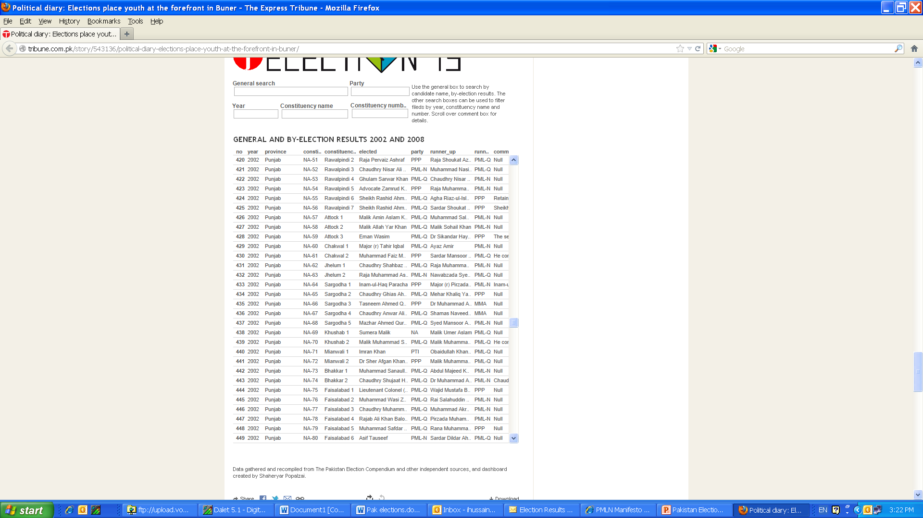

Slide 20
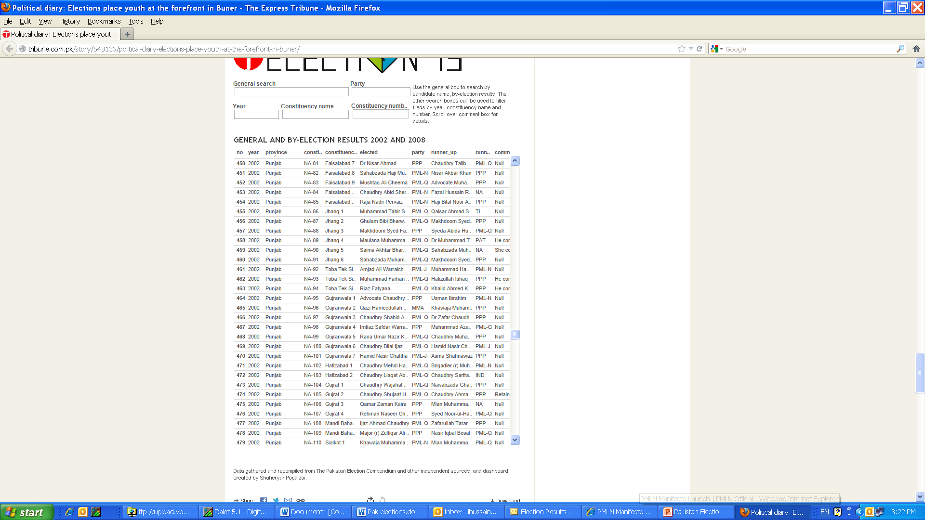

Slide 21


Slide 22


Slide 23


Slide 24
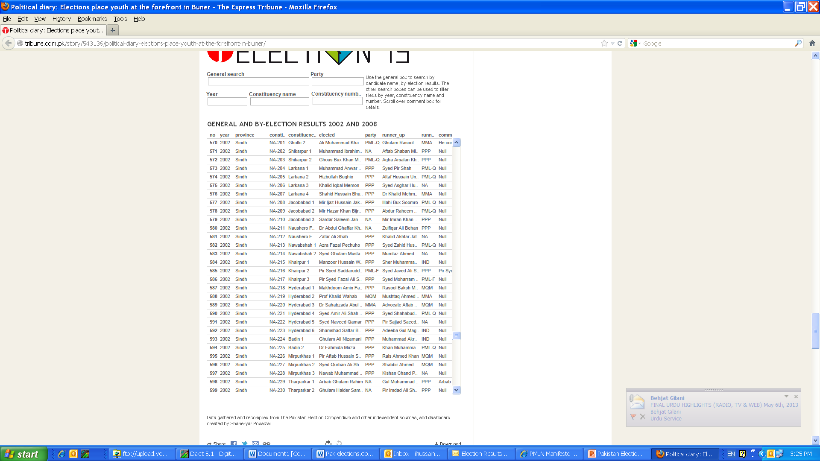

Slide 25
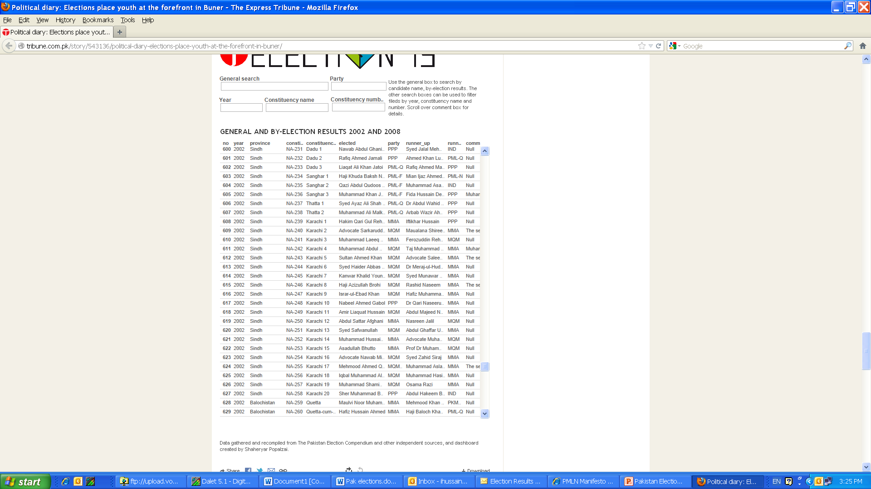

Slide 26
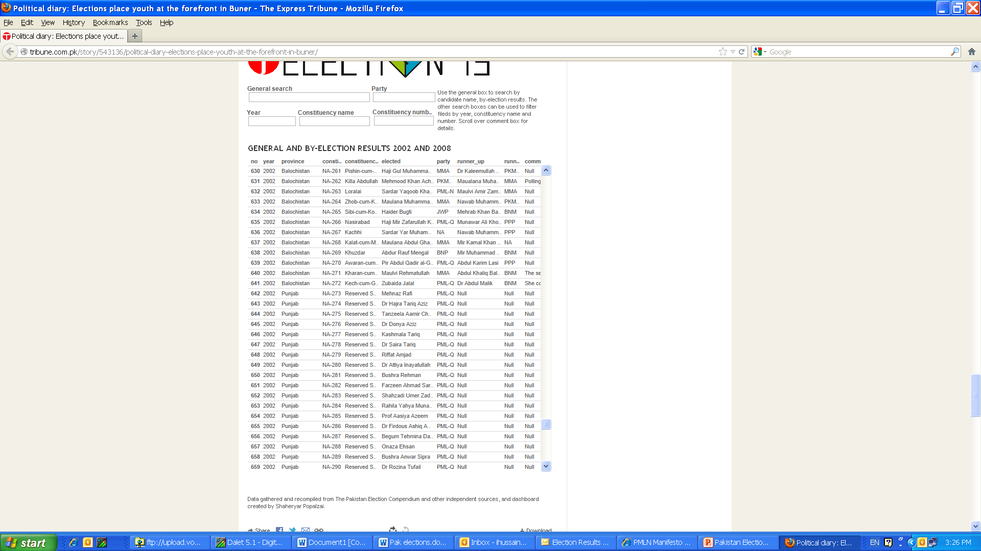

Slide 27
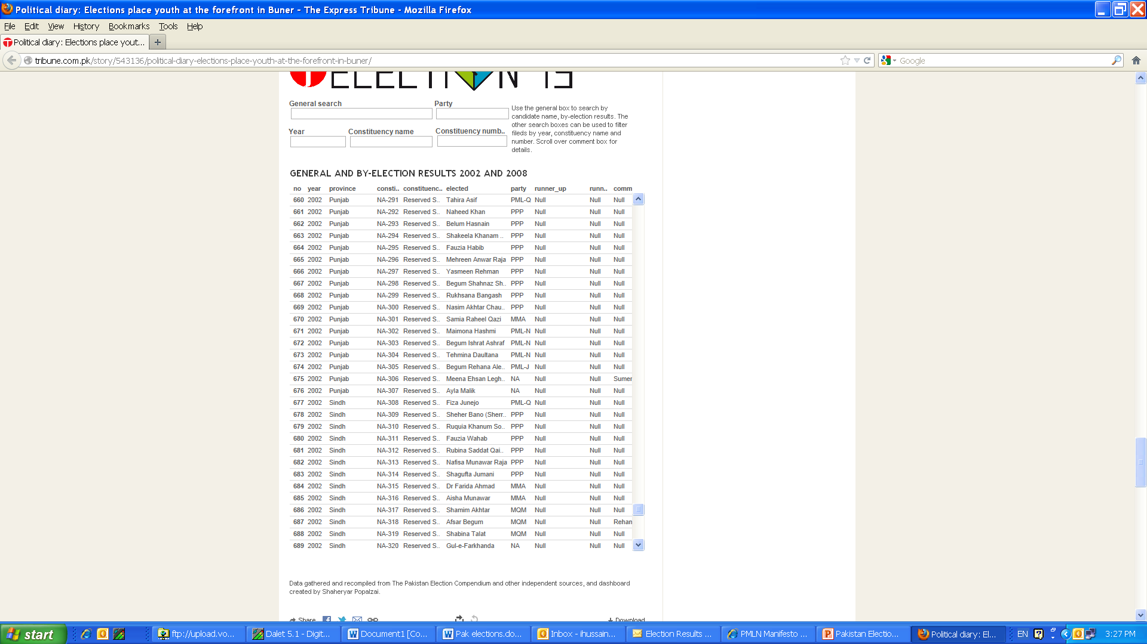

Slide 28
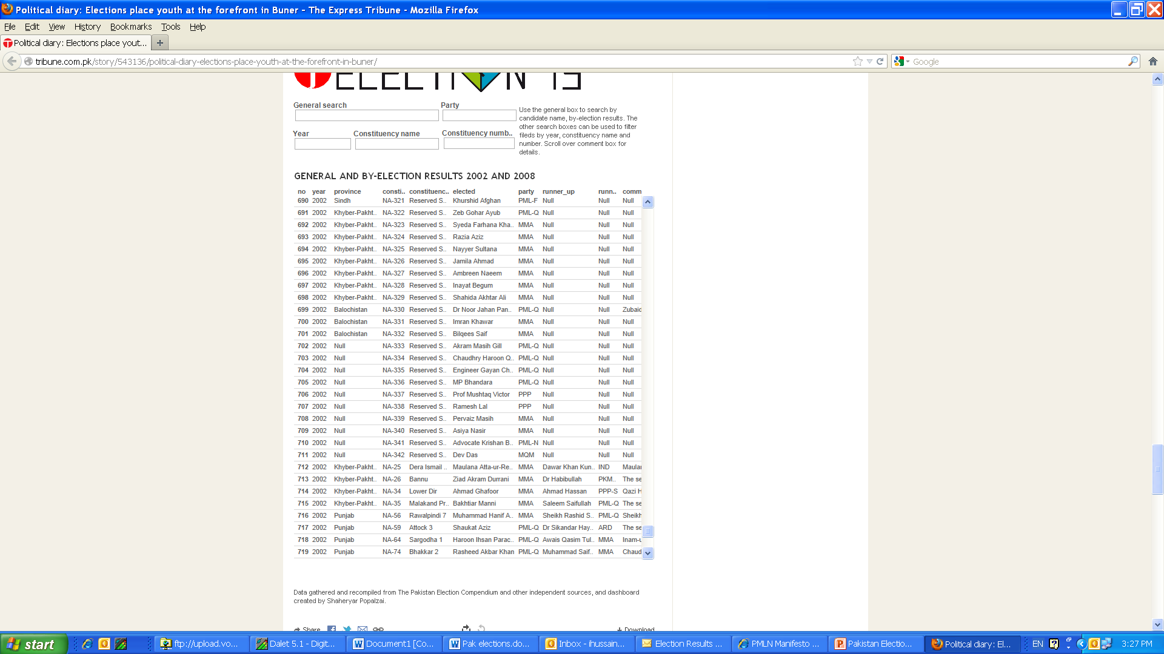

Slide 29
